Slide 1
Connected and Autonomous Robotic Systems
Project Advisor: Prof. Kaikai Liu
Team Members: Jay Parsana
Prashant Gandhi
Saumil Shah Vatsal Makani
Notes:
‹#›

Slide 2
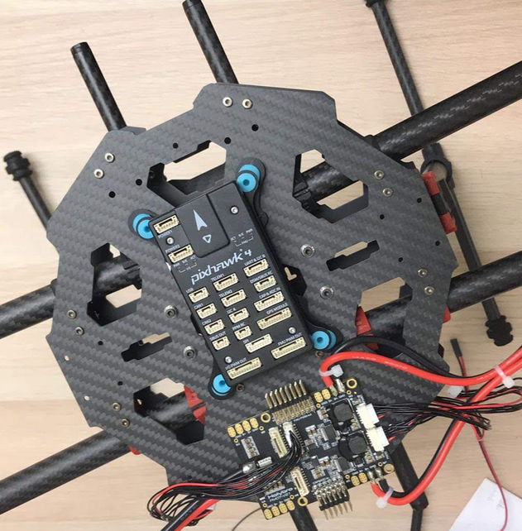
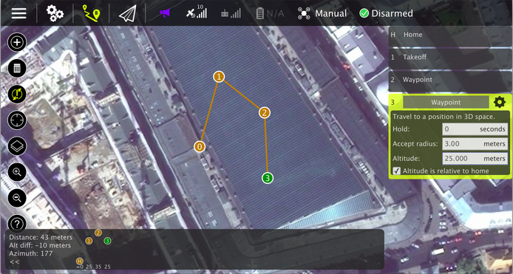
Pixhawk 4
Open source autopilot hardware.
Four onboard sensors:
Accel/Gyro: ICM-20689
Accel/Gyro: BMI055
Magnetometer: IST8310
Barometer: MS5611
Runs PX4 software on top of NuttX OS
Communicate with Ground Station using MAVLink wireless communication protocol.
MAVLink

Slide 3
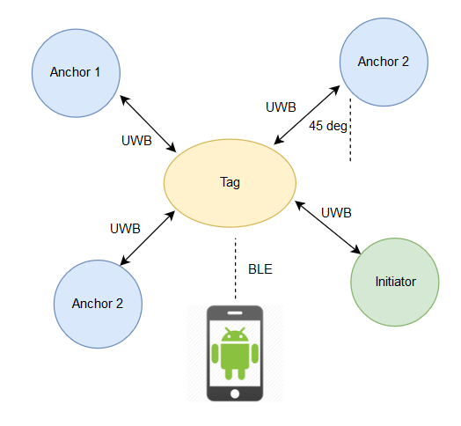
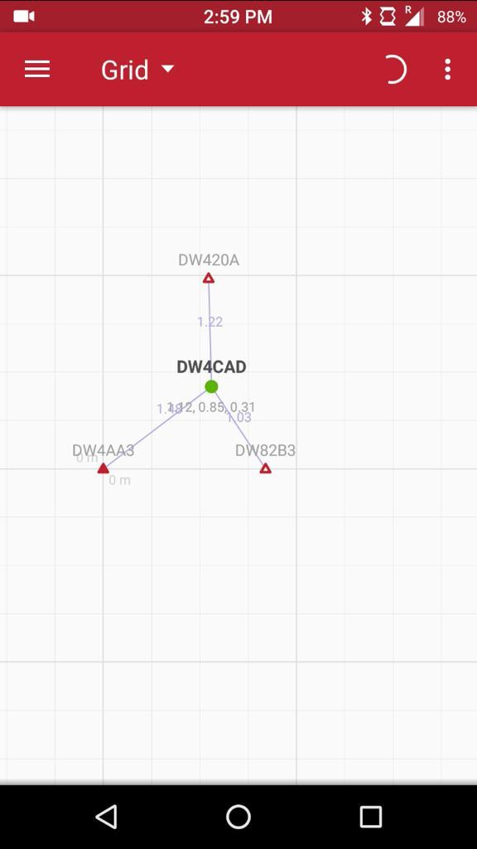
UltraWide Band Beacon
Notes:
‹#›

Slide 4
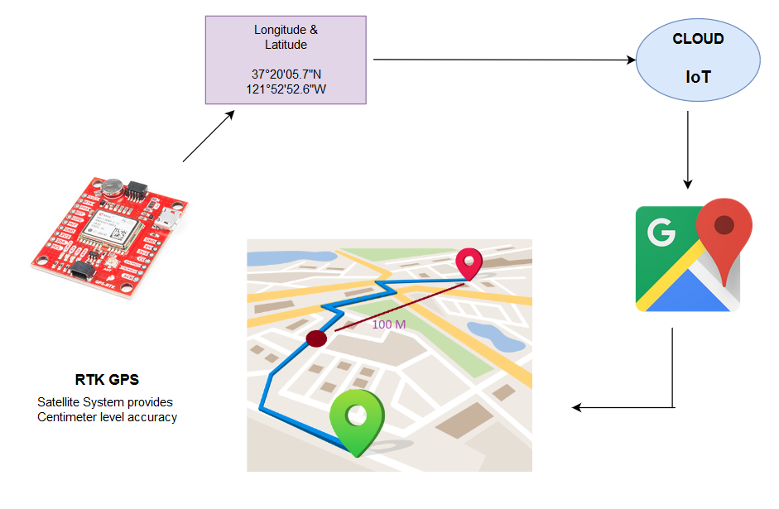
GPS Positioning
Notes:
‹#›

Slide 5
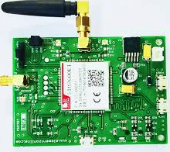
Sensor data and publishing it on cloud using IoT
Temperature
Humidity
Pressure sensors
GPS data
LTE Module
Accelerometer and Gyroscope
Proximity sensors
MQTT Protocol
IoT
(AWS/GCP)
Notes:
‹#›

Slide 6
Thank You

